Slide 1
Introduction to Qur’an

Slide 2
Introduction
The word Qur’an (قرآن) means the recited one
Qur’an has more than 50 names
e.g. Al-Huda, Al-Nur, Al-Furqan

Slide 3
Qur’an: the Word of Allah (S.W.T)
وَإِنْ أَحَدٌ مِّنَ الْمُشْرِكِينَ اسْتَجَارَكَ فَأَجِرْهُ حَتَّى يَسْمَعَ كَلاَمَ اللّهِ ثُمَّ أَبْلِغْهُ مَأْمَنَهُ ذَلِكَ بِأَنَّهُمْ قَوْمٌ لاَّ يَعْلَمُونَ
If anyone from the mushrikin ask you for asylum, grant it to him so that he may hear the Word of Allah, and then escort him to his place of safety: this should be done because these people do not know the truth. [Surah al-Tauba: 6]

Slide 4
Revelation of the Qur’an
Difference between (انزلنا) and (نزلنا)
Revelation continued for about 23 years
Revelation started with:
اقْرَأْ بِاسْمِ رَبِّكَ الَّذِي خَلَقَ
“Read in the Name of your Lord Who created!”

Slide 5
Last Verse of the Qur’an
الْيَوْمَ أَكْمَلْتُ لَكُمْ دِينَكُمْ وَأَتْمَمْتُ عَلَيْكُمْ نِعْمَتِي وَرَضِيتُ لَكُمُ
الإِسْلاَمَ دِينًا
“This day I have perfected your religion for you and completed my bounties upon you and have chosen for you Islam as the religion.” [Al-Maida: 3]
وَاتَّقُواْ يَوْمًا تُرْجَعُونَ فِيهِ إِلَى اللّهِ ثُمَّ تُوَفَّى كُلُّ نَفْسٍ مَّا كَسَبَتْ وَهُمْ لاَ يُظْلَمُونَ
And be conscious of the Day on which you shall be brought back unto God, whereupon every human being shall be repaid in full for what he has earned, and none shall be wronged . [Al-Baqara: 281]

Slide 6
Qur’an: Preserved in the Original Form
إِنَّا نَحْنُ نَزَّلْنَا الذِّكْرَ وَإِنَّا لَهُ لَحَافِظُونَ
Behold, it is We Ourselves who have bestowed from on high, step by step, this reminder? and, behold, it is We who shall truly guard it [from all corruption]. [Al-Hijr : 9]

Slide 7
Preservation of the Qur’an
Preservation in the Time of the Prophet (S.A.W)
Memorization and regular recitation by the Prophet (S.A.W) and the Sahaba
Written Record of the Verses
Scribes of Revelation: Around 65 Companions in total including: Zayd Ibn Sabit, Mu‘az Ibn Jabal, Ubay Ibn Ka‘ab, Abu Zayd, etc.

Slide 8
Compilation of the Qur’an
Caliphate of Abu Bakr (R.A)
Caliphate of Usman (R.A)

Slide 9
History of the Text of Qur’an
Vowelization
Segmentation
Surah
114
Aayah
6216 or 6236 or 6666

Slide 10
Segmentation
Manzil or Hizb
3, 5, 7, 9, 11, 13, 65
Rukoo‘
558
Paras
30

Slide 11
Miraculous Qualities of the Qur’an: A Literary Miracle
Qur’an: The Most Important Miracle Given to the Prophet (S.A.W)
وَإِنْ كُنْتُمْ فِي رَيْبٍ مِمَّا نَزَّلْنَا عَلَىٰ عَبْدِنَا فَأْتُوا بِسُورَةٍ مِنْ مِثْلِهِ
وَادْعُوا شُهَدَاءَكُمْ مِنْ دُونِ اللهِ إِنْ كُنْتُمْ صَادِقِينَ ﻩ فَإِنْ لَمْ تَفْعَلُوا وَلَنْ تَفْعَلُوا فَاتَّقُوا
النَّارَ الَّتِي وَقُودُهَا النَّاسُ وَالْحِجَارَةُ ۖ أُعِدَّتْ لِلْكَافِرِينَ
If you are in doubt as to whether the revelations which We have sent to
Our servant are from Us or not, then produce one Surah like this; and
call your witnesses besides Allah to assist you, if you are right in your
claim. (Al-Baqarah: 23)

Slide 12
Literary Qualities of the Qur’an: the Arabic Language
Arabic is the most ancient language of the world
Ancient languages tend to be closer to nature and are more precise as compared to modern languages
إِنَّا جَعَلْنَاهُ قُرْآنًا عَرَبِيًّا لَّعَلَّكُمْ تَعْقِلُونَ
Behold, We have caused it to be a discourse in the Arabic language, so that you might understand. [Al-Zukhruf: 3]

Slide 13
Origin of Language
وَعَلَّمَ آدَمَ الأَسْمَاء كُلَّهَا ثُمَّ عَرَضَهُمْ عَلَى الْمَلاَئِكَةِ فَقَالَ أَنبِئُونِي بِأَسْمَاء هَـؤُلاء إِن كُنتُمْ صَادِقِينَ
He taught Adam the names of all things; then He presented the things to the angels and said: “Tell Me the names of those if what you say is true?” [Al-Baqara: 31]
Ancient languages are inspired languages
Modern languages are derived from ancient languages and therefore they are not very precise.

Slide 14
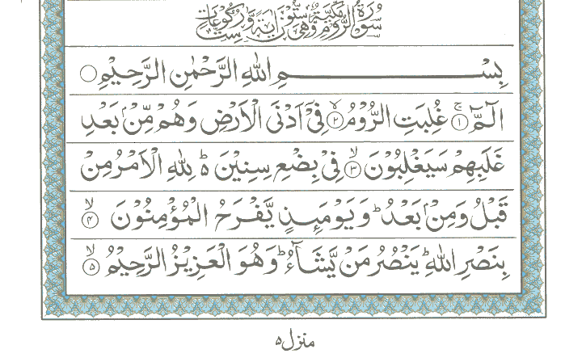
Historical Facts in the Qur’an: Roman Victory over the Persians
Alif Lam M'im. The Romans have been defeated, in the neighboring land, but they, after this defeat, will soon be victorious, within a few years. The command lies with Allah in the past instance as well as in the future. On that day the believers will rejoice (for the victory of the Romans as well as their own victory against the pagans) with the help of Allah. He helps whom He pleases and He is the Almighty, the Most Merciful.

Slide 15
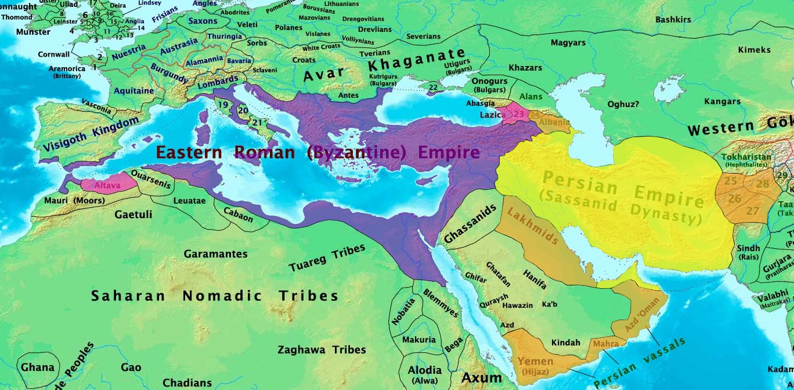

Slide 16
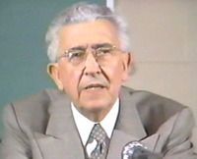
Historical Facts in the Qur’an: Professor Maurice Bucaille’s Research on Fir‘aun
1974: French Government got the permission of the Egyptian Government to conduct autopsy of Fir‘aun’s Mummy
Maurice Bucaille: Head of the Panel that conducted research on the mummy, converted to Islam

Slide 17
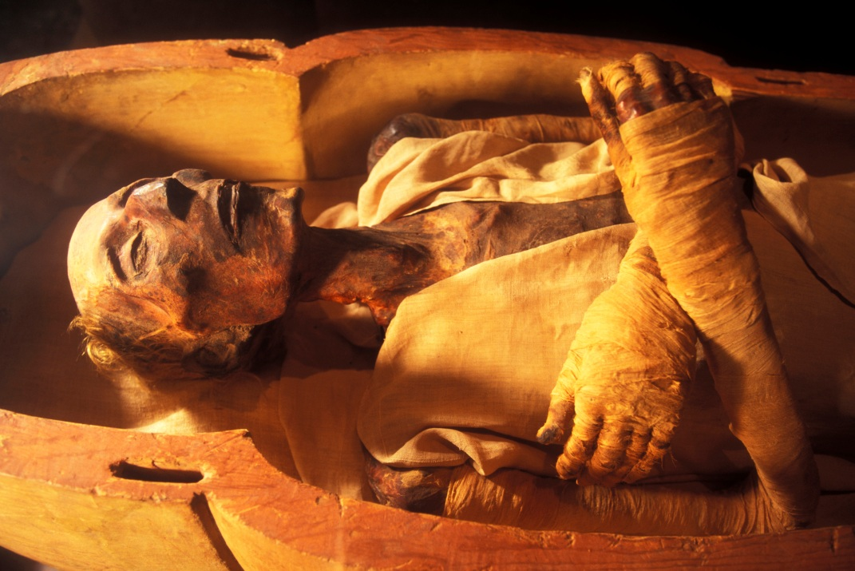
Historical Facts in the Qur’an: Fir‘aun
فَالْيَوْمَ نُنَجِّيكَ بِبَدَنِكَ لِتَكُونَ لِمَنْ خَلْفَكَ آيَةً وَإِنَّ كَثِيرًا مِّنَ النَّاسِ عَنْ آيَاتِنَا لَغَافِلُونَ
We shall save your body this day, so that you may become a sign for the succeeding generations, indeed many among mankind are heedless of Our signs! [Al-Yunus: 92]

Slide 18
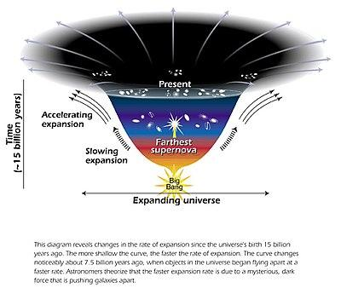
Big Bang and the Expansion of the Universe
أَوَلَمْ يَرَ الَّذِينَ كَفَرُوا أَنَّ السَّمَاوَاتِ وَالْأَرْضَ كَانَتَا رَتْقًا فَفَتَقْنَاهُمَا ۖ
Have not the unbelievers ever considered that the skies and the earth were once one mass, then We split them asunder? [Al-Anbiyaa: 30]
وَالسَّمَاء بَنَيْنَاهَا بِأَيْدٍ وَإِنَّا لَمُوسِعُونَ
And it is We who have built the universe with [Our creative] power; and, verily, it is We who are steadily expanding it. [Al-Zariyat: 47]

Slide 19
Qur’an: the Book of Guidance
ذَٰلِكَ الْكِتَابُ لَا رَيْبَ ۛ فِيهِ ۛ هُدًى لِلْمُتَّقِينَ
This is The Book in which there is no doubt. It is a guide for those who are God conscious. [Al-Baqara: 2]
Qur’an is definite and authentic without any errors or doubts
Qur’an is the Book of Guidance

Slide 20
Qur’an: The Book of Guidance
الر ۚ كِتَابٌ أَنْزَلْنَاهُ إِلَيْكَ لِتُخْرِجَ النَّاسَ مِنَ الظُّلُمَاتِ إِلَى النُّورِ
بِإِذْنِ رَبِّهِمْ إِلَىٰ صِرَاطِ الْعَزِيزِ الْحَمِيدِ
Alif Laam Raa. (Oh Messenger!) This is a Book which We have revealed to you so that you may bring mankind out of utter darkness (ways of ignorance) to the light; by the leave of their Rabb, to the Way of the Mighty, the Praiseworthy (Allah).

Slide 21
Main Subjects in the Qur’an
God, His Attributes and Names and His Acts and Creations
Spiritual Wisdom and the Path towards God
Descriptions of the Afterlife and the next world
Stories of Past Nations
Arguments for belief in Allah (S.W.T)
Laws and Ethics for Life

